Slide 1
Introduction to Agentic Coding
Agentic Coding for Geospatial
Ujaval Gandhi
Spatial Thoughts
ujaval@spatialthoughts.com

Slide 2
Introduction to Agentic Coding

Slide 3
AI Agents
Agents are software systems that are able to complete tasks on behalf of the users.
Instead of user prompting the model at each step for a response, Agents can plan, execute multi-step workflows.
The core principle is the ReAct loop (reasoning and acting) [reference]
Reason → Act → Observe → Repeat

Slide 4
Agentic Coding
Agentic coding involves setting high-level goals than line-by-line prompts or copy/pasting code from AI Assistants.
The agent plans a coding task, executes changes across multiple files, runs the code, fixes errors, checks the outputs and iterates based on results.
If the code throws an error, the agent reads the output, reasons through the failure, and applies a fix on its own
This paradigm shifts the developer's role from writing every line to reviewing, directing, and validating the agent's work.

Slide 5
How to build an Agent?
LLMs themselves can only generate a response from a prompt.
You need a system that can use LLMs to perform agentic codings tasks. This system is the “Agent Harness”.
Harness turns LLMs into Agents
Agent = Model + Harness

Slide 6
Key Features of an Agent Harness
Tool Access
Has access to tools to manage code (i.e. Git), run shell commands, call APIs etc.
Memory
Has context on the previous executions and user preferences
Workspace
Has access to files, runtime environment and operating system
Guardrails
Has the ability to manage permissions, and enforce policies

Slide 7
Claude Code
Claude Code is the agentic harness around Claude models by Anthropic.
One of the most popular coding agent in the market.
It is a closed-source system that is tightly integrated with Claude models and Anthropic APIs.
Other competitors to Claude Code include
OpenAI Codex
Gemini CLI
GitHub Coilot CLI
The ecosystem is more-or-less standardized on the feature set.
Cost and Model performance are the key factors in determine your choice of agent harness.

Slide 8
Open Source Coding Agents
Many open-source alternatives exists that provide similar functionality.
OpenCode
Pi
DeepSeek Harness
Model choice and flexibility are the main factors driving adoption of open-source harnesses.
You can pick from a wide range of models
You can use local models running on your own machine
You get a lot more visibility and transparency on the execution flow.

Slide 9
Configuring the Environment

Slide 10
CLAUDE.md
CLAUDE.md is a special file containing instructions for your agent.
This file is loaded into context at the beginning of every session.
Types of instructions
Project instructions: Project specific guidelines. Saved inside the project folder and only used when Claude Code is invoked from that folder.
User instructions: Your system-wide preferences. Used in all Claude Code sessions.
Content needs to be in the Markdown format.
No specific layout. Keep it short and human readable.
CLAUDE.md is not compatible with other agents.
AGENTS.md is the open-standard used by Codex and many agentic systems.

Slide 11
Introduction to Markdown

Slide 12
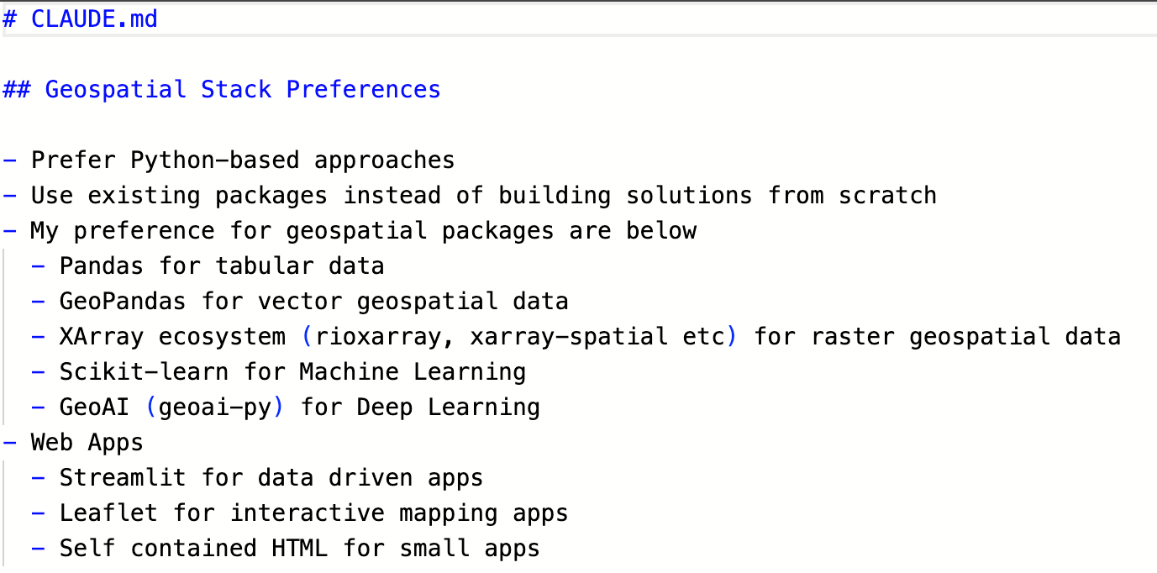
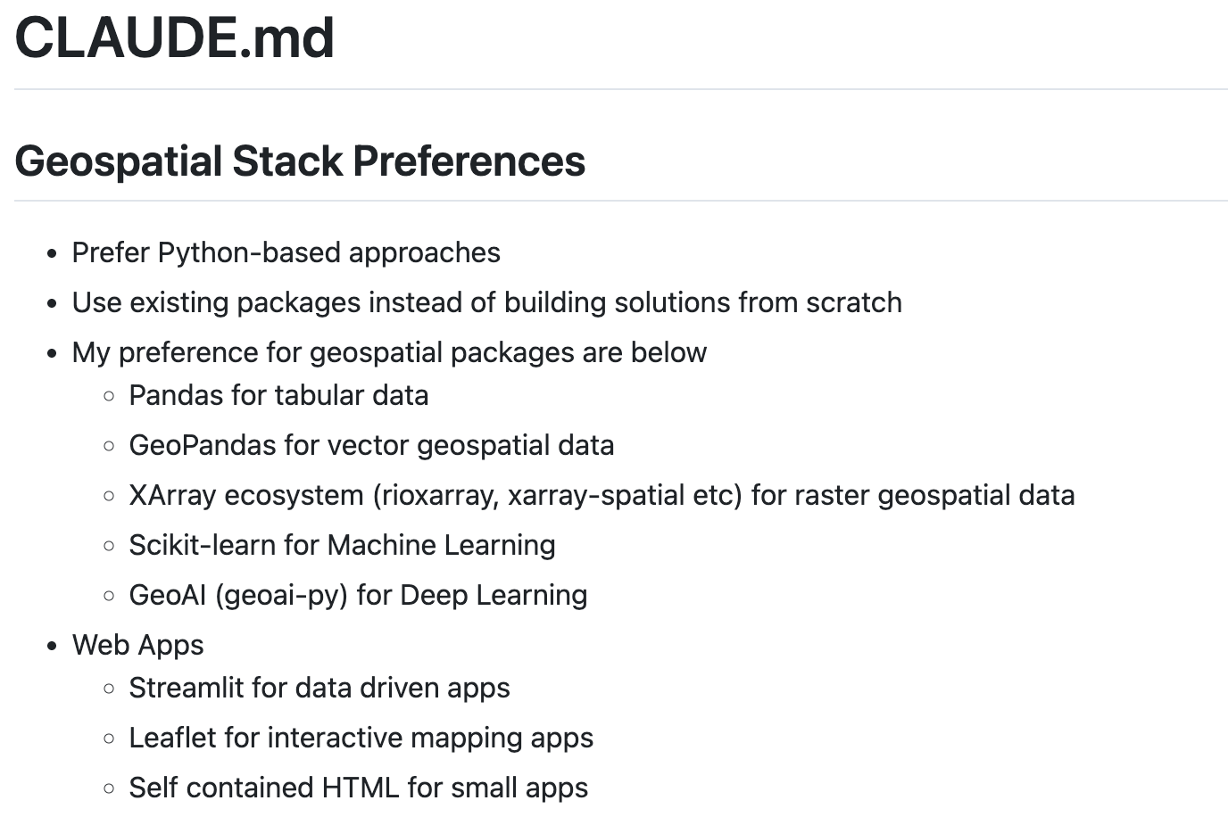
Markdown
Markdown Text
Markdown is a simple formatting language to create structured documents.
Plain text formatting that is easy to read and write for humans and computers.
It is a widely used standard for creating documents and websites
Markdown documents can be easily converted to other formats (PDF, Word, HTML) without worrying about styling and format-specific formatting.
Rendered HTML

Slide 13
Flavors of Markdown
The original Markdown specifications supports basic syntax - which is limiting for many applications.
There is a superset of Markdown that support an extended syntax.
Tables
Code Blocks
Footnotes
…
GitHub supports the GitHub-flavored Markdown syntax which supports the full extended syntax, plus some GitHub-specific additions.
Tip, Notes, Alerts
Diagrams, Mathematical expressions
Referencing GitHub issues, users

Slide 14
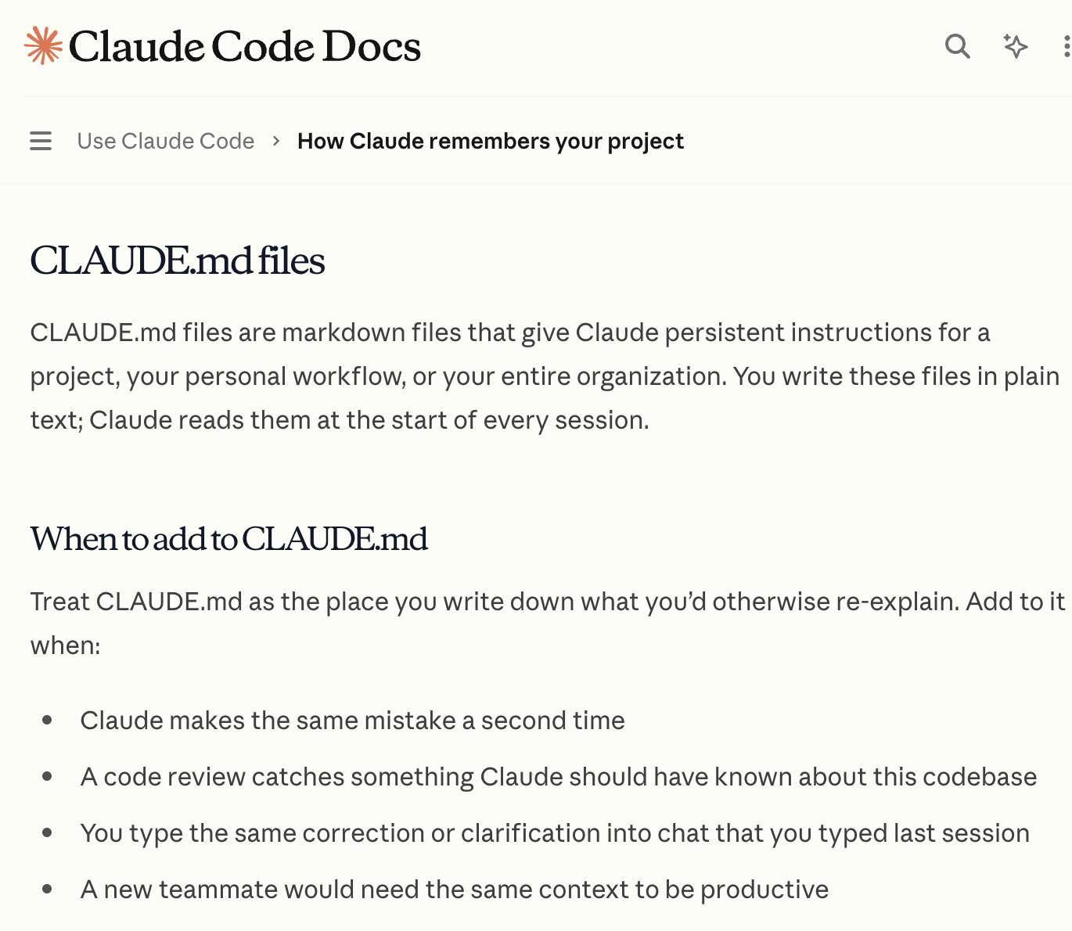
Markdown is the language of AI
AI systems use Markdown as a native format to structure content
Markdown is easier for LLMs to parse and makes them more effective than HTML/PDFs
Markdown in prompts helps AI recognize structure and prioritize instructions.
Headings, bullet points, tables convey useful structure information
Claude Code uses Markdown as the language for configuration and production of human-readable artifacts.

Slide 15
Agentic Coding Best Practices

Slide 16
Stay in the loop
Explore → Plan → Code
[ Agent ] Explore the data and flag issues.
[ Agent ] Use “Plan mode” to create a plan.
[ Human ] Review, edit and update the plan.
[ Agent ] Write and execute the code.
[ Human ] Validate the results.

Slide 17
Provide Context
To ensure the code matches your expectation and uses correct methods - you can provide references.
Add authoritative documents - research papers, reports, manuals.
Use this paper as a reference [link to paper]
Point to example patterns.
Write code using the pattern in this tutorial [link to tutorial]

